Slide 1
STOR 455 Review of Midterm 1
Read: 4.7

Slide 2
Midterm 1
February 28. Class time.
15% of course grade. No make-up.
Instructions for Midterm 1 posted on Sakai.
Covers every lecture up to today and all HWs.
Class on Feb. 23 as a review of materials.
Answer questions in class through Gradescope.

Slide 3
Types of Variables
Quantitative: expressible as numbers for which arithmetic makes sense
Categorical: divides sample points into groups
Binary = categorical with just two groups

Slide 4
Building a Statistical Model: Four Step Process
1. CHOOSE – Pick a form for the model
2. FIT – Estimate any parameters
3. ASSESS – Is the model adequate? Could it be simpler? Are conditions met?
4. USE – Answer the question of interest

Slide 5
General form of a model:
Random Error
“Expected” Y for some combination of predictors
=
+
Data
Model
Error

Slide 6
Residuals
Using the predicted value for each sample case the residual is
Residual = $y −\hat{y}$
Predicted
Actual

Slide 7
Simple Linear Model
response
random error
Y = β_{o} + β₁X + ε
intercept
predictor
slope
Assume: ε ~ N( 0, σ_{ε}) and independent
Three parameters to estimate: β_{o}, β₁, σ_{ε}

Slide 8
Fitting a Simple Linear Model
Given $\overline{x}, \overline{y}, s_{x}, s_{y}, r$, the least squares estimates of the intercept ${\hat{β}}_{0}$and slope ${\hat{β}}_{1}$are given by
${\hat{β}}_{1}=r s_{y}$/ $s_{x}$
${\hat{β}}_{0}$= $\overline{y}$- ${\hat{β}}_{1}$ $\overline{x}$
Remark: The regression line always passes the point ($\overline{x}, \overline{y}$).

Slide 9
Simple Linear Model- Conditions
Model:
Linearity: The means for Y vary as a linear function of X.
Error:
Zero Mean: The distribution of the errors is centered at zero.
Constant variance: The variance for Y is the same at each X. (Homoscedasticity)
Independence: No relationships among errors.
Normality:
Residuals are normally distributed
(sometimes) At each X, the Y’s follow a normal distribution.

Slide 10
Standardized Residuals
For residuals: mean=0 and std. dev. $≈{\hat{σ}}_{ε}$
Standardized
Residual ≈
Look for values
beyond ±2 (mild) or beyond ±3
(almost)
Definition: The standardized residuals are:
Leverage

Slide 11
Studentized Residuals
Definition: The studentized residuals are:
Using model fit without i^{th} case

Slide 12

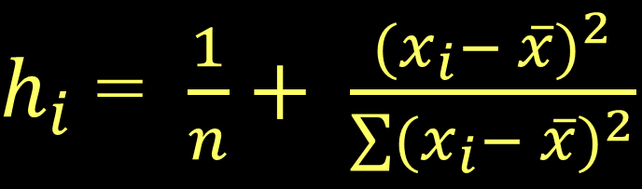
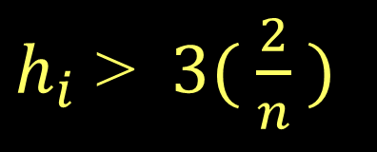
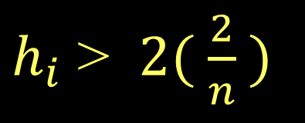
Typical Leverage
$h_{i}$ = $\frac{1}{n}+ \frac{{(x_{i}− \overline{x})}^{2}}{\sum{{(x_{i}− \overline{x})}^{2}}}$
For a simple linear model:
= 1+ 1 = 2
Look for:
$h_{i}$ > $2( \frac{2}{n} )$
or
$h_{i}$ > $3( \frac{2}{n} )$

Slide 13
Cook’s Distance
How much would the fit change if one data value were omitted?
k is the number of predictors. In SLM k=1.
D_{i} increases with either poor fit (std.res_{i}) and high leverage (h_{i}).
Compare to other D_{i}’s.
Study any case with D_{i} > 0.5; worry if D_{i} > 1.0.

Slide 14
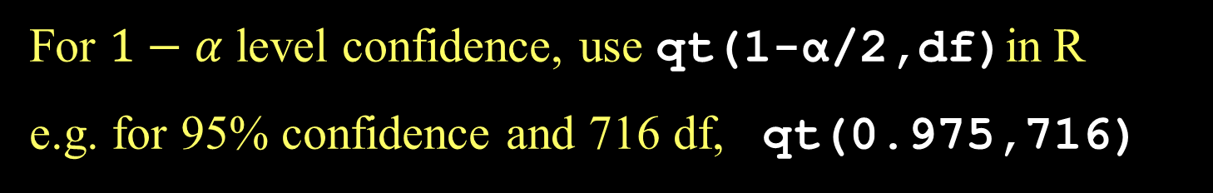
CI for Slope or Intercept
t* comes from a t-distribution with n-2 d.f and depends on the level of confidence
For $1−α$ level confidence, use qt(1-α/2,df)in R
e.g. for 95% confidence and 716 df, qt(0.975,716)

Slide 15
CI for μ_{Y} when X=x*
SSX = $\sum{{(x_{i} − \overline{x})}^{2}}$

Slide 16
Prediction Interval for Individual Y’s when X=x*
accounts for ε in model
SSX = $\sum{{(x_{i} − \overline{x})}^{2}}$

Slide 17
T-test for slope in SLM:
Which is best?
H_{o}: β₁=0
H_{a}: β₁≠0
Compare to t _{n-2}
All three are equivalent in SLM!
ANOVA for regression in SLM:
H_{o}: β₁=0
H_{a}: β₁≠0
Compare to F_{1,n-2}
T-test for correlation in SLM:
(t_{n-2})² = F_{1,n-2}
H_{o}: ρ =0
H_{a}: ρ ≠0
Compare to t _{n-2}

Slide 18
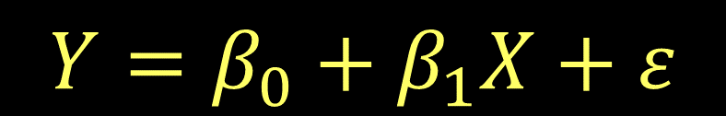
Multiple Regression Model
$$Y=β_{0}+β_{1}X_{1}+β_{2}X_{2}+⋯β_{k}X_{k}+ε$$
$$Y=β_{0}+β_{1}X+ε$$
k predictors
where ε ~ N( 0, σ_{ε}) and independent
Data?
We need n data cases, each with values for Y and all of the predictors X₁,...,X_{k}.

Slide 19
T-test for Slope
Note: We now have multiple “slopes” to test
All given in R with a p-value
H_{o}: β_{i}=0
H_{a}: β_{i}≠0
Compare to t _{n-k-1}
lose 1 d.f. for each coefficient
Reject H_{o}⬄The i^{th} predictor is useful in this model

Slide 20
Example
(Estimate Std Error t value Pr(>|t|)
Intercept) 34121.649 29716.458 1.148 0.2668
Size 23.232 17.700 1.313 0.2068
Lot ? 3.075 1.839 0.0834
F-statistic: 10.69 on 2 and 17 DF, p-value: 0.000985
What is the missing estimate of the slope of “Lot”?

Slide 21
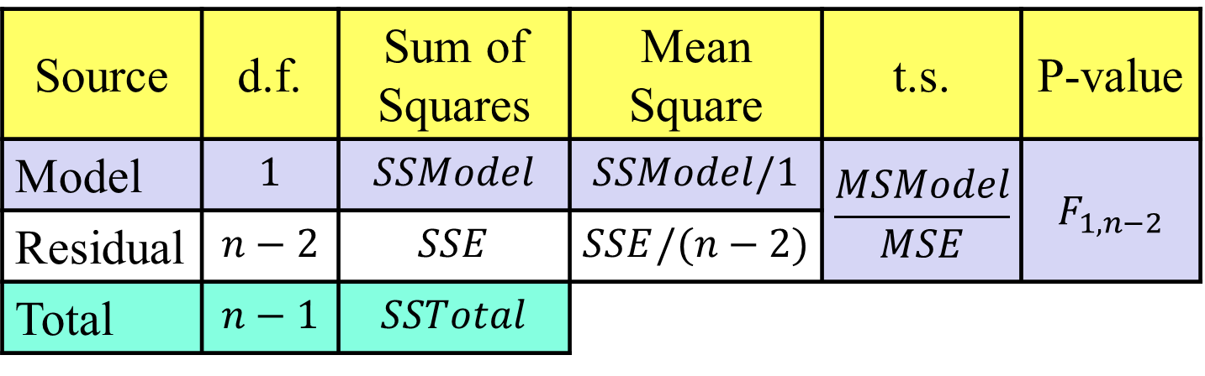
ANOVA test for Overall Fit
weak model
H_{o}: β₁= β₂=...=β_{k}= 0
H_{a}: Some β_{i} ≠ 0
effective model
Source | d.f. | Sum of Squares | Mean Square | t.s. | P-value
Model | $$1$$ | $$SSModel$$ | $$SSModel/1$$ | $$\frac{MSModel}{MSE}$$ | $$F_{1,n−2}$$
Residual | $$n−2$$ | $$SSE$$ | $$SSE/(n−2)$$
Total | $$n−1$$ | $$SSTotal$$
k
k
F_{k,n-k-1}
n-k-1
(n-k-1)

Slide 22
Coefficient of Multiple Determination
Now interpreted as the % of variability in the response variable (Y) that is “explained” by a linear combination of these predictors.

Slide 23

How do we detect multicollinearity?
Look at a correlation matrix of the predictors.
Compute the Variance Inflation Factor (VIF).
(Beware if VIF > 5)
i
where R_{i}² is for predicting X_{i} with the other predictors.
i
$$VIF > 5 ⇔ Ri2 >80\%$$
i

Slide 24
Adjusted R²
Recall:
(adjusts for the number of predictors in the model)

Slide 25
Example
> anova455(HouseModel)
ANOVA Table
Model: Price ~ Size + Lot
Df Sum Sq Mean Sq F value P(>F)
Model 2 4.8048e+10 2.4024e+10 10.693 0.000985 ***
Error 17 3.8196e+10 2.2468e+09
Total 19 8.6244e+10
---
Signif. codes: 0 ‘***’ 0.001 ‘**’ 0.01 ‘*’ 0.05 ‘.’ 0.1 ‘ ’ 1
What is R² and the Adjusted R² ?

Slide 26

Mallows’ C_{p}
Note: R², Adjusted R², SSE, all depend only on the predictors in the model being evaluated – NOT the other potential predictors in the pool.
Mallow’s C_{p}: When evaluating a subset of m predictors from a larger set of k predictors,
reduced
full
m = # predictors in the reduced model

Slide 27
Example
A full model with 100 observations and 9 predictors has an MSE of 17.1065. The regression with a subset of 4 predictors has an SSE of 1561.317. What is the Mallows’ Cp for this subset of predictors?
1561.317 / 17.1065 + 2(4+1) – 100 = 1.27039

